Slide 1
Title of the Problem Statement: Health care Diagnostic Centre.

Slide 2
Description:
This Python script implements a Flask-based web application for medical image diagnosis. It allows users to upload medical images related to breast MRI, skin cancer, and diabetic retinopathy. The uploaded images are processed using pre-trained deep learning models to make predictions about the presence of diseases. The application consists of routes for different parts of the interface (main page, about page, and diagnosis pages), image processing functions, model loading, and prediction routes. It provides a simple and intuitive web interface for users to quickly assess the likelihood of various diseases based on their uploaded images.

Slide 3
Team Members Details:
Gangalakurthi Nikhil Venkata Krishna
Purandewari Anantha
Syed Sameedh
Duggisetty Mukesh

Slide 4
The Problem it Solves:
Breast Cancer Detection: By allowing users to upload breast MRI images, the application utilizes a pre-trained deep learning model to analyze the images and determine the presence of breast cancer. Early detection of breast cancer is crucial for timely medical intervention and improving patient outcomes.
Skin Cancer Detection: Users can upload skin images for analysis, enabling the application to use another pre-trained model to detect signs of skin cancer. Skin cancer is one of the most common types of cancer globally, and early detection significantly increases the chances of successful treatment.
Diabetic Retinopathy Detection: For individuals with diabetes, the application offers the capability to upload retinal images to detect signs of diabetic retinopathy. Diabetic retinopathy is a leading cause of blindness in adults and can be effectively managed if detected early through regular screening.

Slide 5
Uses Cases:
Individuals Concerned About Their Health:
Self-screening: Individuals can use the application to upload medical images (e.g., breast MRI, skin images) for preliminary screening of potential health issues such as breast cancer or skin cancer.
Early Detection: By regularly monitoring their health through the application, individuals can detect any abnormalities early and seek medical advice promptly, leading to timely intervention and improved treatment outcomes.
Healthcare Professionals for Preliminary Screening:
Primary Care Physicians: Healthcare providers, including primary care physicians, can utilize the application as a preliminary screening tool during patient consultations. They can quickly assess whether further diagnostic tests or specialist referrals are necessary based on the application's predictions.
Telemedicine: In telemedicine settings, healthcare professionals can request patients to upload medical images through the application for remote assessment, enabling timely diagnosis and treatment planning.

Slide 6
Educational Purposes in Medical Training:
Medical Students and Residents: Medical students and residents can use the application as a learning tool to understand the process of medical image analysis and interpretation. They can upload sample images to observe how the deep learning models predict various medical conditions, enhancing their diagnostic skills.
Continuing Medical Education (CME): Healthcare professionals pursuing continuing medical education can engage with the application to stay updated on advancements in medical imaging technology and diagnostic methodologies, improving their clinical practice.
Public Health Initiatives:
Screening Campaigns: Public health organizations can integrate the application into screening campaigns aimed at raising awareness and promoting early detection of diseases such as breast cancer, skin cancer, and diabetic retinopathy. The application can serve as a convenient and accessible tool for individuals to participate in screening initiatives from the comfort of their homes.

Slide 7
Challenges:
Model Performance and Accuracy
Data Privacy and Security
Scalability and Performance
User Interface and Experience (UI/UX)
Model Interpretability
Diversity and Generalization
Regulatory Compliance

Slide 8
Technologies Used:
Flask
TensorFlow
Keras
PIL (Python Imaging Library)
HTML and CSS
Jinja2

Slide 9
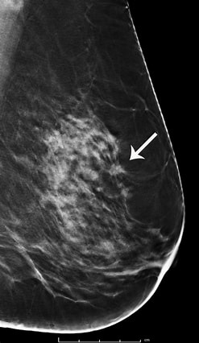
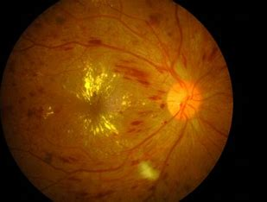
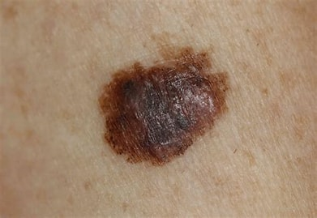
Eye
Skin
Breast

Slide 10
Video Drive Link:
https://drive.google.com/file/d/1-4ATncUdvTF2k_9Z_06PqgAssFXhzPTo/view?usp=sharing

